Slide 1

The Mysteries of Be Star
A Comparative Study of the Be Stars Gamma Cassiopeiae and Xi Persei
Group 1
Speaker: Yixuan Shao
Co-Authors: Anthony Lawrenc Chavez, Xianzhe Tang
Venue: ESS 450 Date: Dec.7, 2023
AST 443: Observational Techniques in Astronomy

Slide 2
Contents
part 1 Intro
What is a Be Star?
Where is Gam Cas and Ksi Per?
Where did we observe the targets?
part 2 Observations
Observations & Data Analysis
How do our data compare to others' observations?
part 3 Conclusion
How the difference between the two targets came about?
What we can’t see in the data?

Slide 3
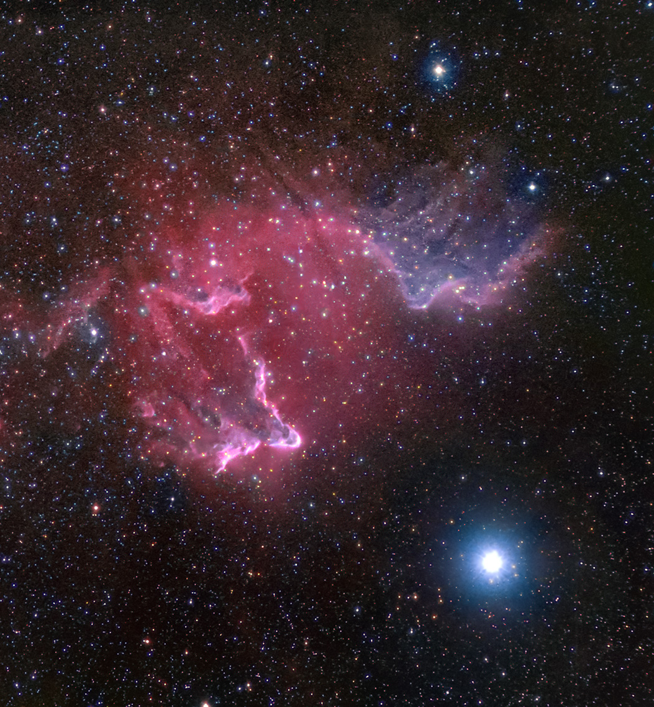
part 1
What is a Be Star?
It’s neither B[e] Star nor Herbig Ae/Be star
So, What is a Classic Be Star?
Non-supergiant stars showing one or more Balmer series lines in emission.
- main sequence stars (but a number of subgiants and giant stars are also included)
- Rapid Rotation
- Dense Circumstellar Equatorial Disk
IC 59&63 - The Gamma Cas Nebula
From Donald P. Waid, Denton, Texas
Notes:
The area affected here is equivalent to a thousand New York City's combined.

Slide 4
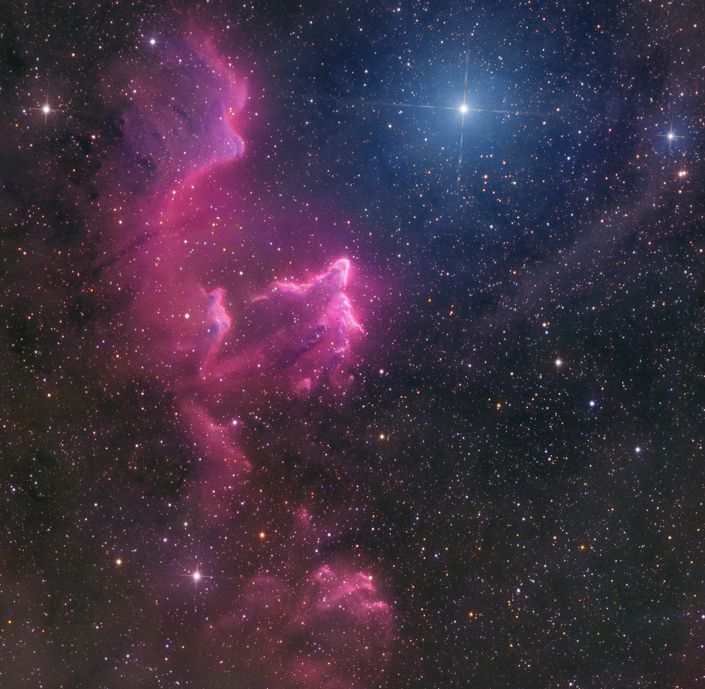
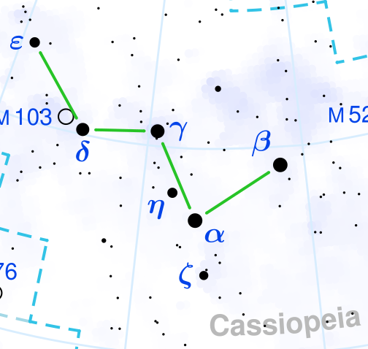
Where is Gam Cas and Ksi Per?
Gamma Cassiopeiae (Gam Cas)
located at R.A. 00:56:42.5 and Dec. +60:43:00.3, which is in the center of the constellation of Cassiopeia.
Apparent Magnitude: 2.47
Spectral Type: B0.5IVe
Star Type: Subgiant Star
Variable Type: γ Cas variable
Data
Mass: 13 M☉
Radius: 10 R☉
Luminosity: 34,000 L☉
Temperature: 25,000 K
Rotational Velocity: 295 km/s
The Gamma Cas Nebula
From Baerenstein Observatory, Marcel Drechsler, German

Slide 5
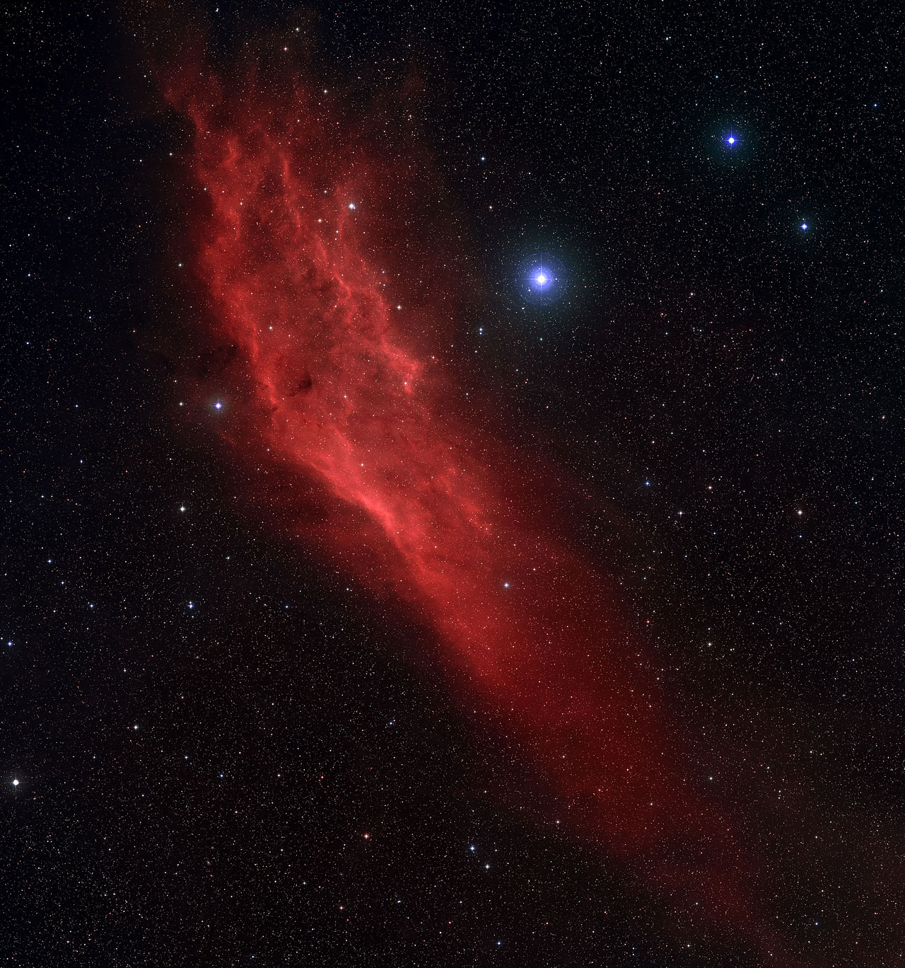
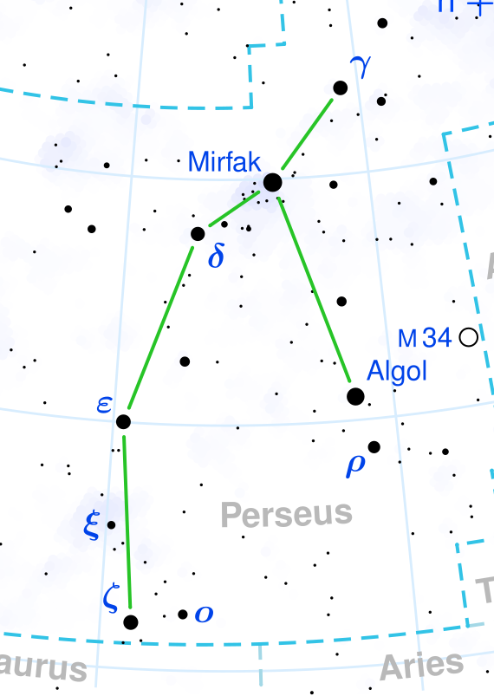
Where is Gam Cas and Ksi Per?
Xi Persei (Menkib, Ksi Per)
located at R.A. 03:58:57.9 and Dec. +35:47:27.7, which is in the constellation of Perseus.
Apparent Magnitude: 4.06
Spectral Type: O7.5III
Star Type: Blue Giant
Variable Type: Slightly Variable
Data
Mass: 26-36 M☉
Radius: 14 R☉
Luminosity: 263,000 L☉
Temperature: 35,000 K
Rotational Velocity: 220 km/s
California Nebula (NGC 1499) & Menkib (Blue star on its right side)
From John Corban, Gresham, OR

Slide 6
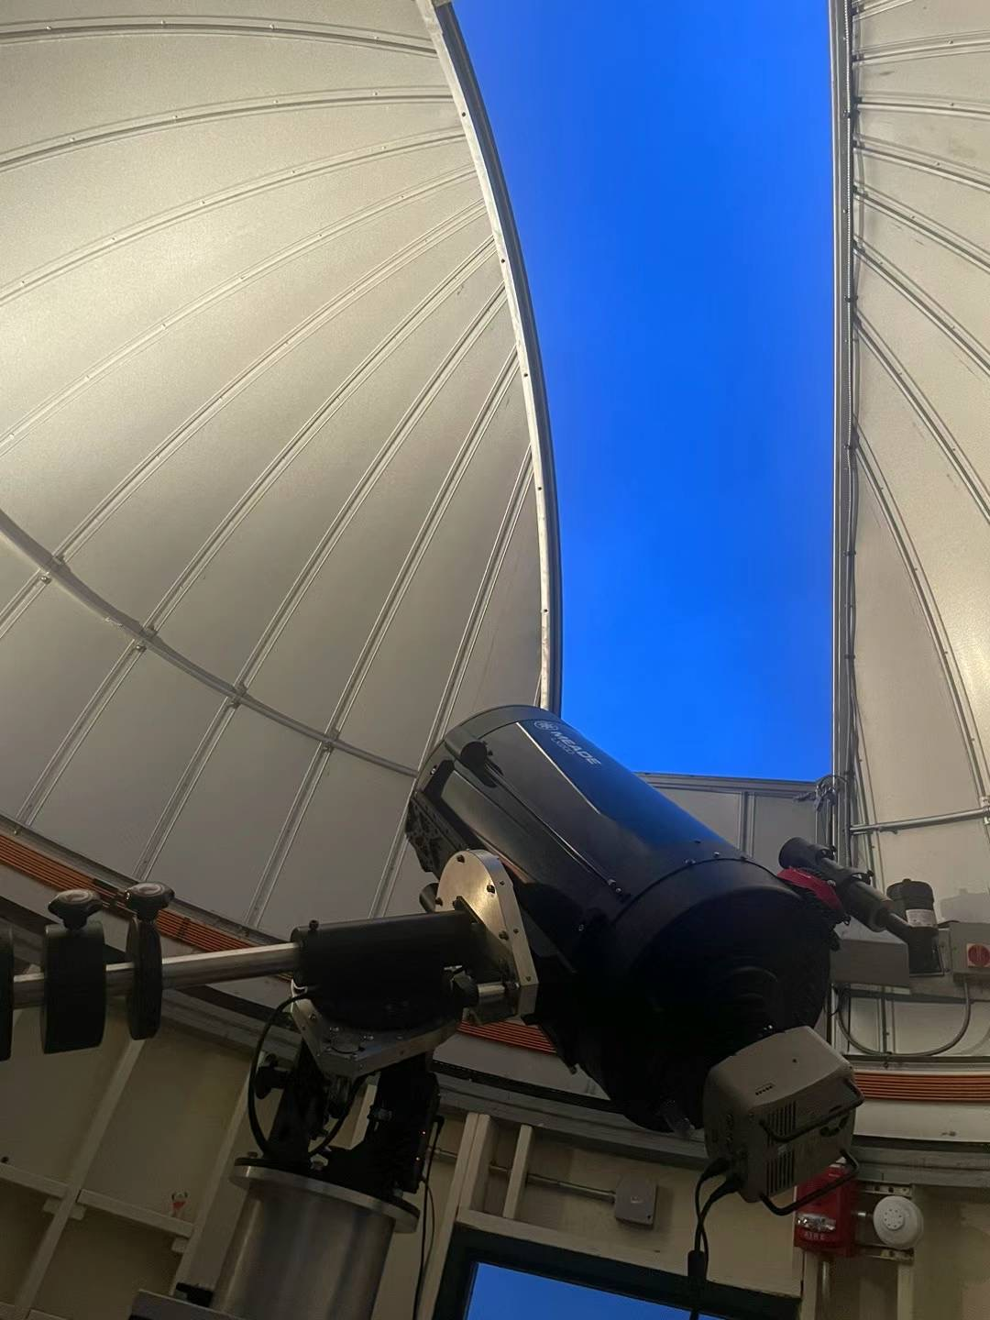

Where and When did we observe the targets?
Our observations were conducted at
the Mt. Stony Brook Observatory,
With
14-inch Meade LX200-ACF telescope
Mesu-200 German Equatorial Mount
SBIG ST-402 CCD camera
the DADOS Spectrograph.
Location: 40.91476 N 73.12568 W
Date: November 2nd , 2023
Time: 06:30 pm. – 01:30 am.
Filter: Visible
Grating: Neon Arclamp
Wavelength Range: 633 nm to 708 nm
Exposure Time: 20s (Gam Cas), 30s (Ksi Per)

Slide 7
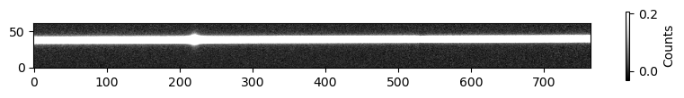
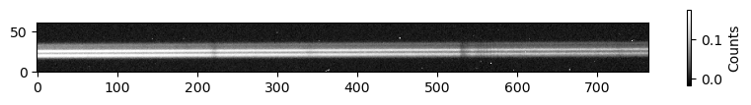
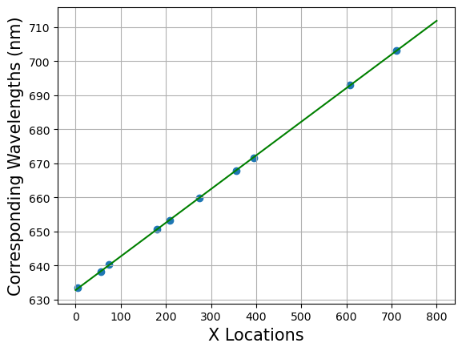
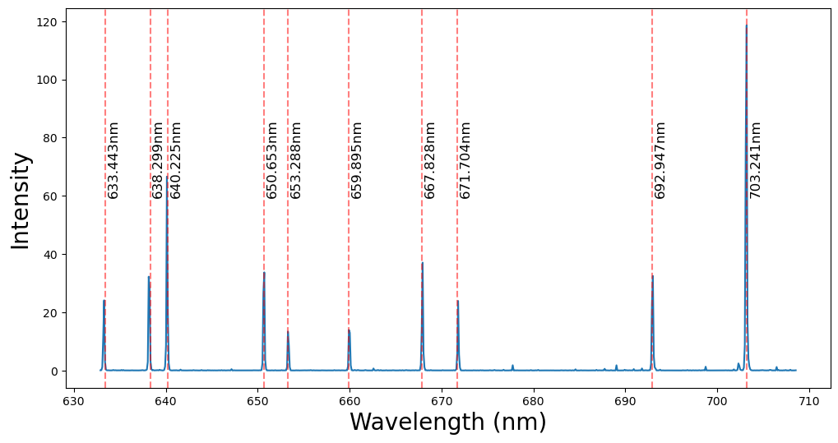
part 2
Calibration
Observations & Data Analysis
Calibrated Science Image of Gam Cas
Calibrated Science Image of Ksi Per
Linear Fit Model For Wavelength vs. Pixel
Calibrated Spectrum of Neon Arclamp
Data from us

Slide 8
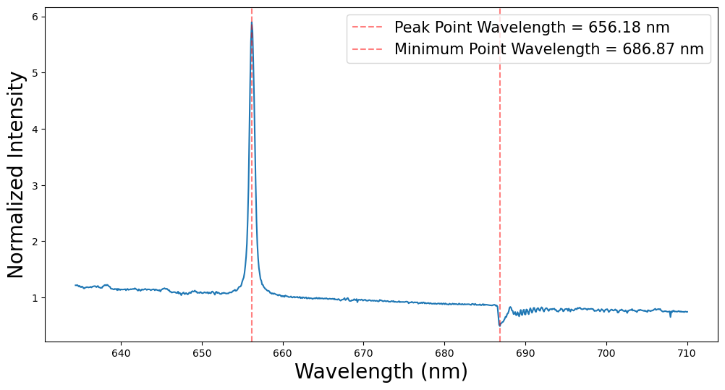
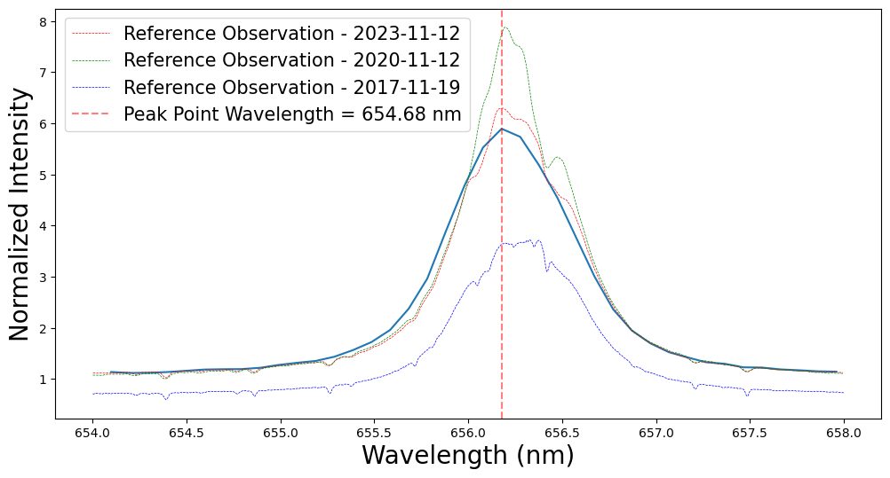
part 2
For Gam Cas
Observations & Data Analysis
It is evident that Gam Cas exhibits a prominent Balmer emission line
Spectrum (633-708nm)
Spectrum (654-658nm)
Data from us with previous observation from BeSS Database
Data from us

Slide 9
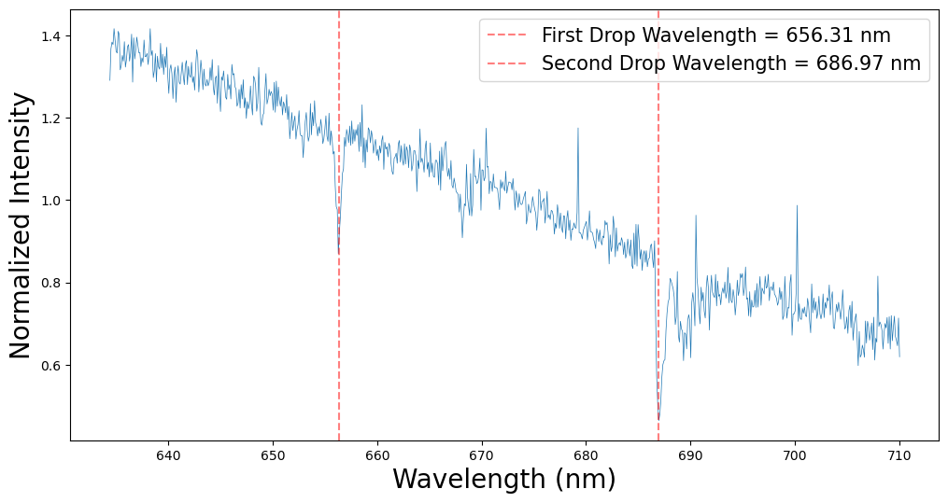
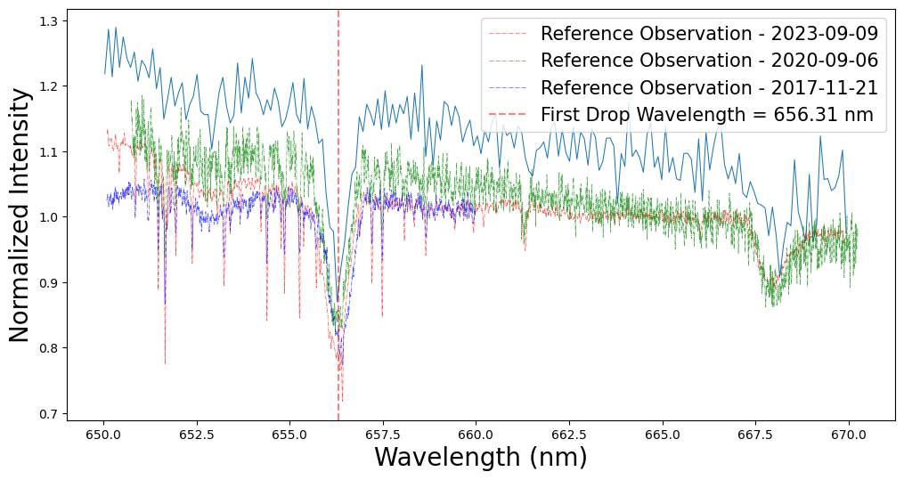
part 2
For Ksi Per
Observations & Data Analysis
Ksi Per exhibits a Balmer absorption line
Spectrum (633-708nm)
Spectrum (650-670nm)
Data from us with previous observation from BeSS Database
Data from us

Slide 10
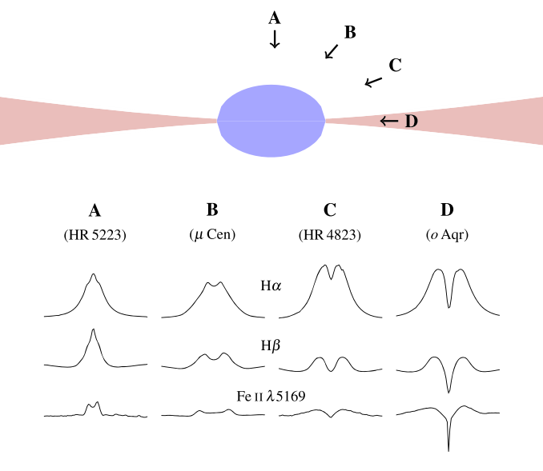
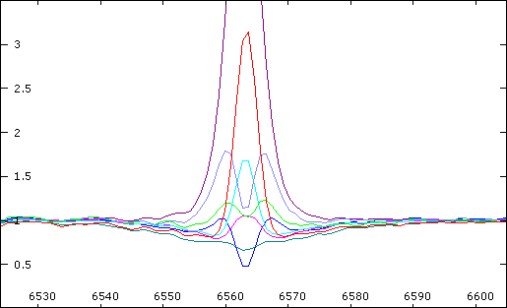
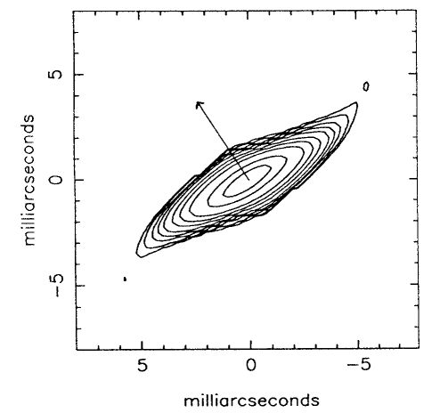
part 3
How the difference between the two targets came about?
Schematic view of a Be star at critical rotation and with a flared disk. The lower part shows example spectral profiles from pole-on to shell Be star taken from Rivinius et al. (2013),fig.1
Observation Direction
Dense Circumstellar disk
Reconstructed Ha intensity map of z Tauri, showing the high axial ratio of the circumstellar environment of this shell star. The polarization angle (denoted by the arrow) is perpendicular to the plane of the disk (from Quirrenbach et al. 1993)

Slide 11
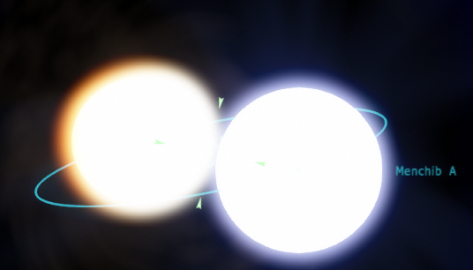
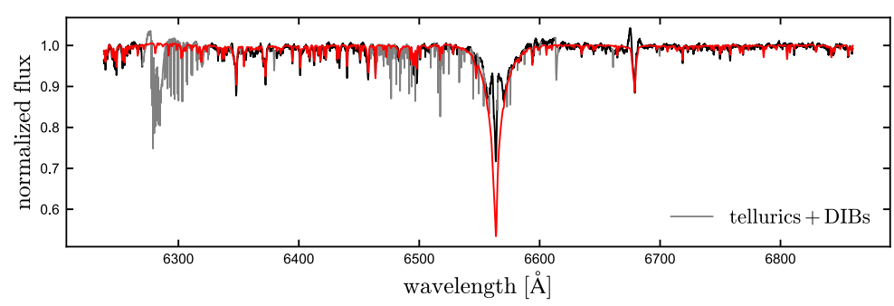
part 3
How the difference between the two targets came about?
Binaries System
Difference between Gam Cas and Ksi Per
In confirmed Be binaries, the companions impose additional constraints on model parameters and can be used as probes;
The tidal forces may help the stellar matter to leave the Be star and form a disk;
A companion might have had an influence on the Be star as a result of previous mass transfer (Rotate Faster)
PEPSI spectrum of HD15124 (black) and best-fitting binary model taken from El-Badry et al. (2022), fig.5

Slide 12
part 3
What we can’t see in the data?
- Effect of rotational velocity on its emission intensity
- Effect of different circumstellar disk on it’s emission/absorption Type
- To determine the effect of binaries or multi-star system on spectrum
Observation Direction
Dens Circumstellar disk

Slide 13
Thank you
Reference
John M. Porter and Thomas Rivinius, “Classical Be Stars”, 2003 PASP 115 1153
Kareem El-Badry, et al., “Birth of a Be star: an APOGEE search for Be stars forming through binary mass transfer”, Monthly Notices of the Royal Astronomical Society, Volume 516, Issue 3, November 2022, Pages 3602–3630.

